Slide 1

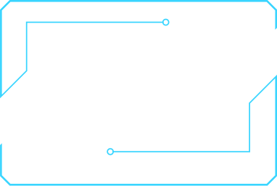

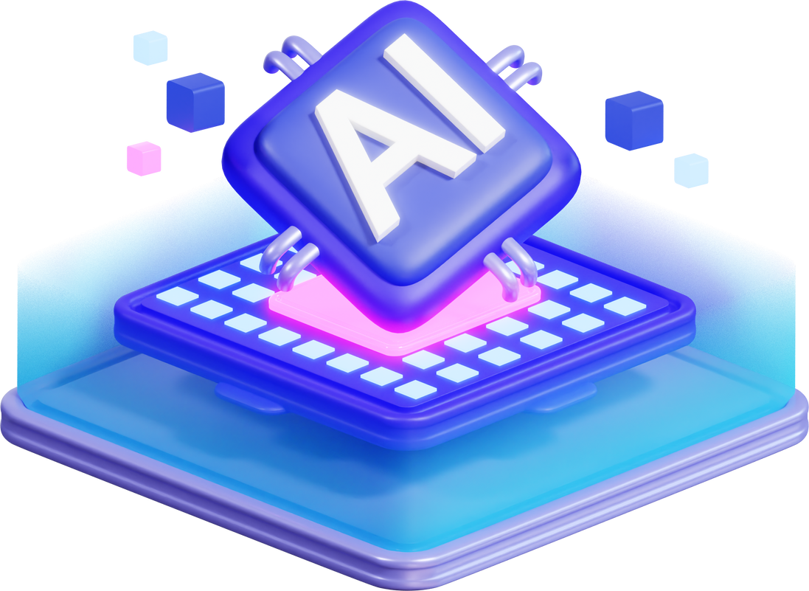


TEAM NEURAL TITANS
Artificial IntelligenceHugging Face Transformers vs. OpenAI GPT-4 API:
A Comparative Analysis

Slide 2
GINYARD INTERNATIONAL CO.
Artificial Intelligence
Revolution

Slide 3
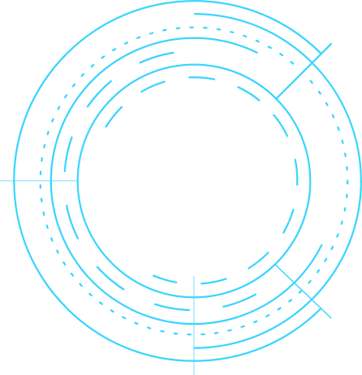
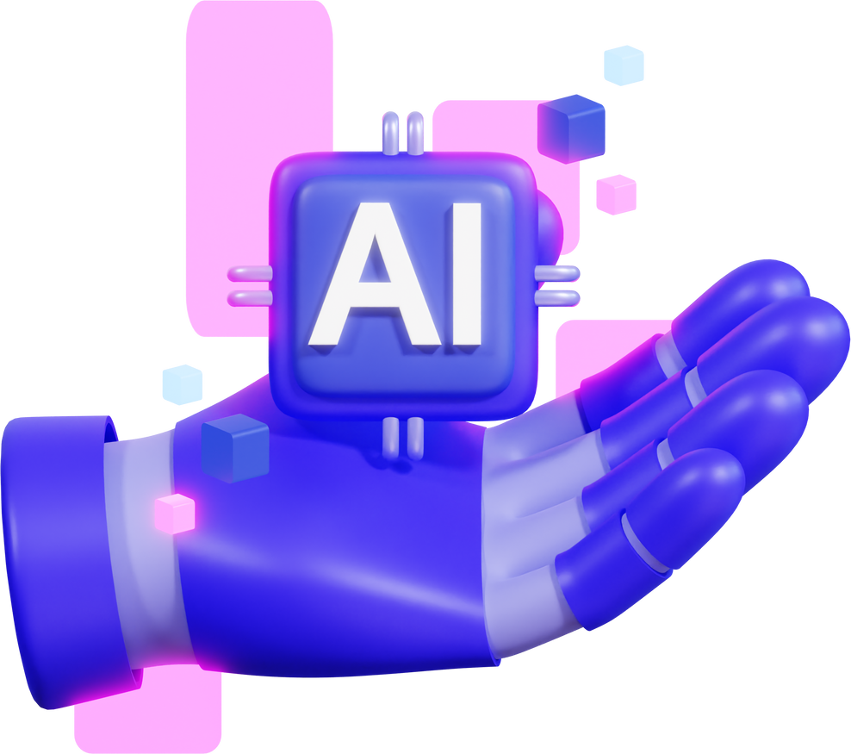
Introduction
Objective: Compare Hugging Face Transformers and OpenAI GPT-4 API in terms of background, features, applications, and performance.
Why This Matters: Both frameworks are leading tools in NLP, but they cater to different use cases and audiences.
Structure of the Presentation:
Background and Origin
Key Features and Advantages
Real-World Applications
Comparative Analysis
Conclusion and Q&A

Slide 4

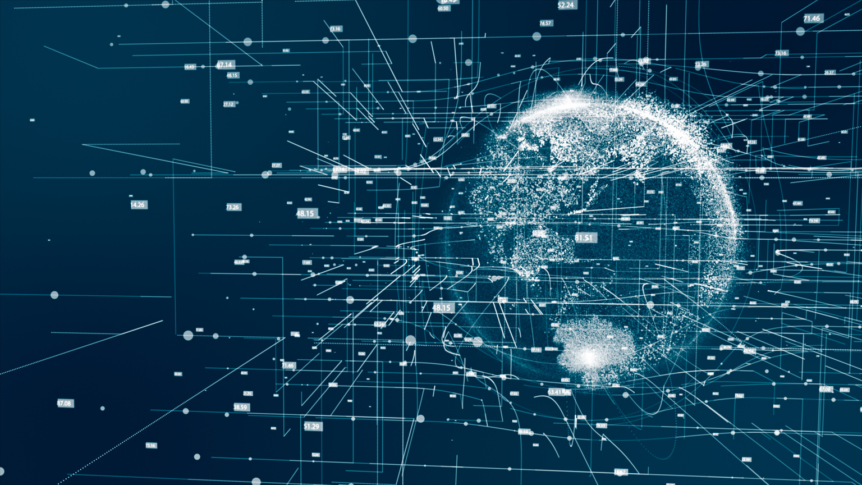

BackGround and Origin
Hugging Face Transformers:
Origin: Launched in 2016 by Hugging Face, previously, it was a chatbot for teenagers in 2016 and later was a company focused on democratizing NLP around 2018-2019
Purpose: Open-source library for state-of-the-art models like BERT, GPT, and T5. There are a total of 102 supported models to utilize with its library
Development: Community-driven, with contributions from researchers and developers worldwide. With the community, it has reached over 1.3 million different open-source AI-based models any can use. Through various way, can even perform API callings using “Gradio”
OpenAI GPT-4 API:
Origin: Developed by OpenAI, a leading AI research organization.
Purpose: Proprietary API providing access to GPT-4, a cutting-edge language model.
Development: Built on years of research, starting with GPT-1 in 2018, evolving to GPT-4 in 2023.

Slide 5
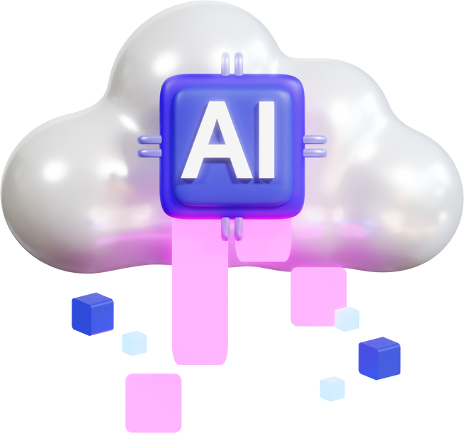
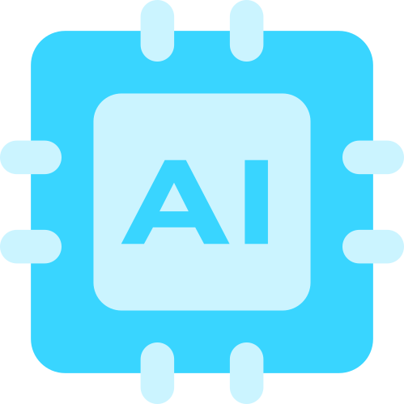
Key Features and Advantages
HUGGING FACE TRANSFORMERS:
OPENAI GPT-4 API:
Open-Source: Free to use, modify, and distribute.
Model Variety: Supports more than a hundred different models within its library “transformers”
Customizability: Fine-tune models on specific datasets when needed for your use.
Community Support: Active forums, tutorials, and integrations (e.g., TensorFlow, PyTorch).
State-of-the-Art Performance: GPT-4 is one of the most advanced language models available.
Ease of Use: Simple API integration for developers.
Scalability: Handles large-scale applications with ease.
Proprietary Features: Advanced capabilities like multi-modal inputs (text + images).

Slide 6
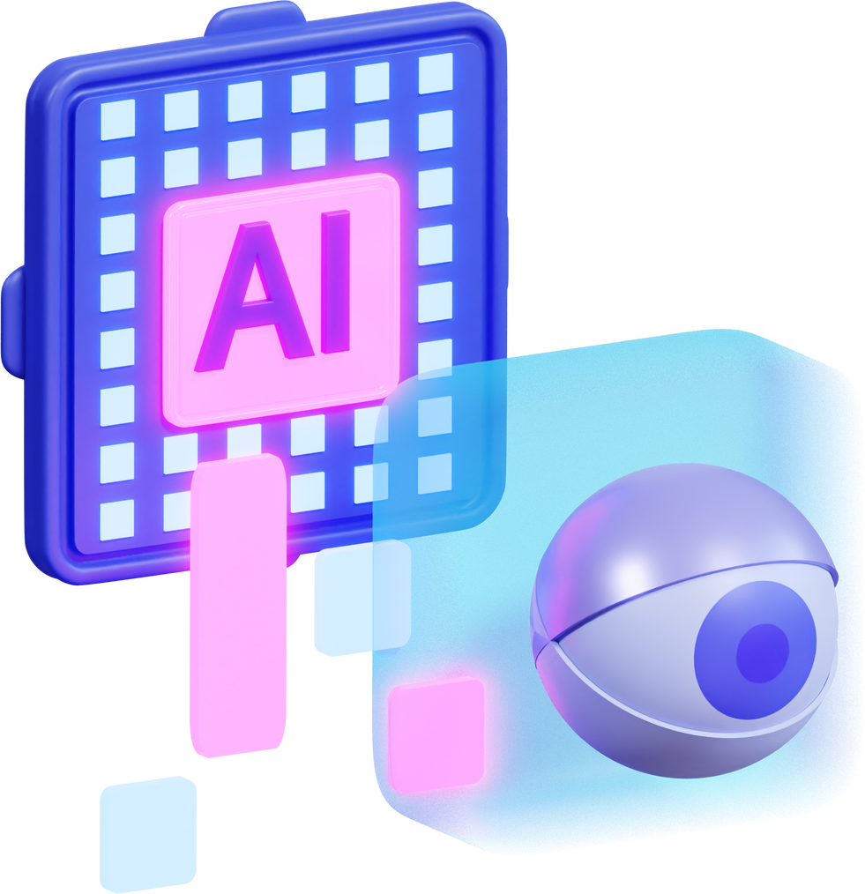
Real-World Applications
Hugging Face Transformers:
Case Study 1: Sentiment Analysis for E-commerce (e.g., Amazon reviews).
Case Study 2: Language Translation for Global Businesses (e.g., Google Translate alternatives).
Case Study 3: Custom Chatbots for Customer Support.
OpenAI GPT-4 API:
Case Study 1: Content Generation for Marketing Agencies.
Case Study 2: Virtual Assistants for Enterprise Applications.
Case Study 3: Medical Diagnosis Support via NLP.

Slide 7
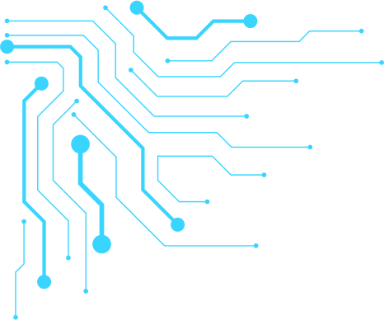
Short Comparative Analysis
Aspect | Hugging Face Transformers | OpenAI GPT-4 API
Usability | Requires coding expertise | Easy API integration
Performance | High (customizable) | State-of-the-art
Support | Community-driven | Professional support
Scalability | Scalable with effort | Highly scalable
Cost | Free (open-source) | Pay-per-use pricing
Customizability | Highly customizable | Limited to API capabilities

Slide 8
Conclusion
Hugging Face Transformers:
Best for developers and researchers who need flexibility and control.
Ideal for utilizing opensource models officially rather than obtaining it from sketchy websites.
This can later help developers use spaces and localized models without relying on different companies tokens.
OpenAI GPT-4 API:
Best for businesses and developers seeking cutting-edge performance with minimal setup.
Ideal for scalable, enterprise-level applications.
Cons:
Hugging Face Transformers:
When using just the library “transformers”, this doesn’t really mean you can use the million different models in huggingface.
OpenAI GPT-4 API:
Even though their name has “open” in it, with each updates, they become more of a private company.
Based on their competitors, they have started to lag behind. Both in chatbots and video generation.

Slide 9
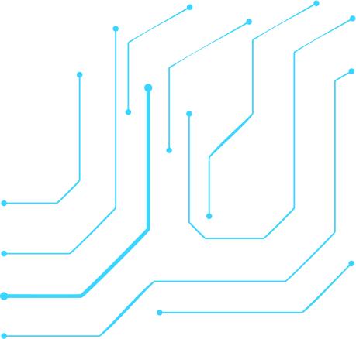
Q&A
You can ask any question regarding this presentation or something that relates with Huggingface and OpenAI

Slide 10
Thank You!
FROM TEAM NEURAL TITANS
We hope this presentation provided valuable insights into Hugging Face Transformers and OpenAI GPT-4 API

